Slide 1
Embedded C Programming
Real-Time Operating Systems
Nitin Chandrachoodan, IIT Madras

Slide 2
Operating Systems

Slide 3
Resource Management
Computers are (and have) resources
Time (computing power)
Memory / Storage (internal / external)
Network communication
Power
Computers run tasks
User interaction
Controlling peripherals
Provide Services
Tasks use Resources

Slide 4
Operating System
Top level program - first program that runs when a computer starts
Take control of all resources
Provide “driver” functionality
Allow other programs to run
Single tasking (switch from OS to task, wait for task to return control)
Multi-tasking (cooperative or pre-emptive)
General purpose OS:
Varied environments, typically large amounts of compute and memory resources
Focus on best user experience
Ease of programming, flexibility, resource sharing
Examples: Linux, MacOS, Windows, … (also Android, iOS)

Slide 5
Embedded Systems Requirements
Limited hardware resources
Limited number/type of processes that will run
Real-time response
Critical tasks with deadlines common
Deterministic behaviour highly desirable
May not need to deal with arbitrary programs

Slide 6
Real-time Operating System (RTOS)
Focus on predictable timing behaviour
Emphasizes determinism, predictability, reliability
Primary purpose
Manage hardware resources
Provide services to other applications
… in order to ensure timely response
Memory management
Usually more restrictive than general purpose OS
Platform availability
General portability is not the main concern - only some platforms may be supported

Slide 7
OS Concepts
Device drivers
Hardware abstraction
Operating system
Key ideas

Slide 8
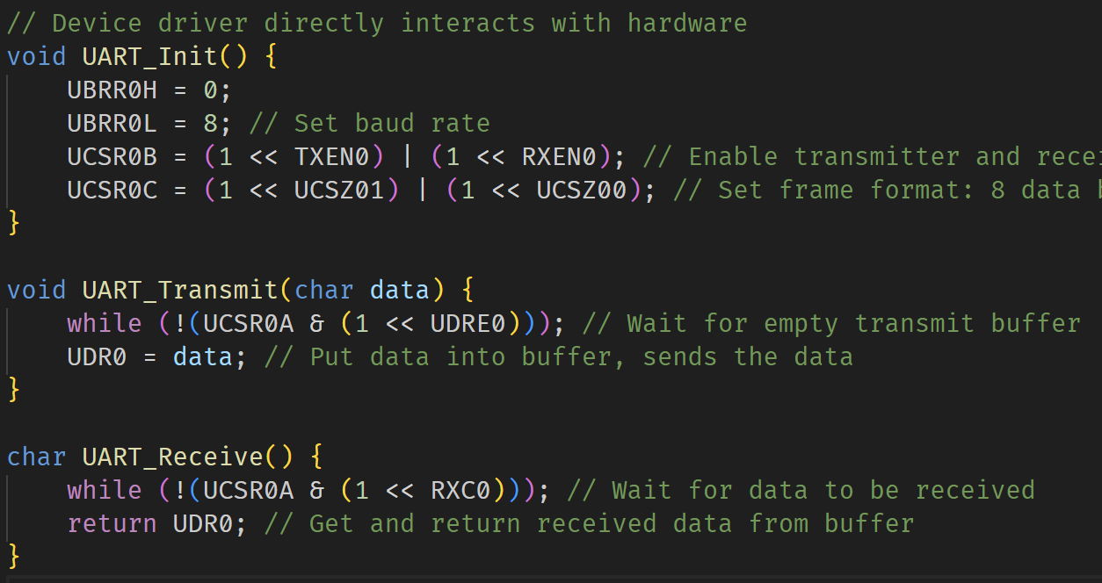
Device Drivers
Why?
Interface with the specific hardware
Generic functions at higher level
Common interface functions: open(), close(), read(), …
How?
Detailed knowledge of specific hardware
Memory map, register settings, …

Slide 9
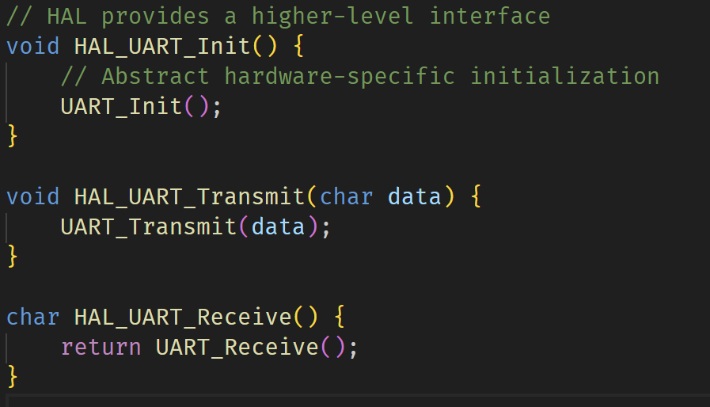
Hardware Abstraction Layer
What?
Generic hardware abstraction - aim for independence from specific hardware
Close to hardware, but more abstract than driver level
How?
Generic defined functions
Conventions

Slide 10
Operating System
Resource control
Provide standard APIs to interact with resources
Build on top of HAL for portability
Hardware specific parts handled by device drivers
HAL builds on top of drivers
OS uses HAL interfaces
OS builds on top of HAL for portability
HAL builds on top of drivers for flexibility

Slide 11
Key Concepts for RTOS: Tasks
A task is an independent unit of execution (sometimes also called a thread)
Own context: registers, stack, …
Different operational states:
running
ready
blocked
suspended
Analogy:
Different workers in a factory with different responsibilities

Slide 12
Key Concepts for RTOS: Scheduling
Tasks are executed (run) on processor - processor time is a resource to be managed
Deciding which task next: scheduling
Ensure high priority tasks are executed promptly
Multiple scheduling algorithms possible:
earliest deadline first
rate monotonic
fixed priority
…
Analogy:
Manager in the factory assigning work or enabling access to resources

Slide 13
Key Concepts for RTOS: Priority
Not all tasks are equally important
Assign priority levels to tasks
Usually a number: convention
High priority tasks can preempt lower priority tasks
Important for efficient resource management
Example:
Engine Temperature Control in automobile is more important than dashboard display

Slide 14
Key Concepts for RTOS: Determinism
Predict with certainty when a specific task will execute / complete
Critical for real-time systems
Deadlines
May not be very fast or short duration
Guarantees are important
RTOS features for providing deterministic execution
Example:
Multiple moving robotic arms working on building a car, operate without bumping into each other

Slide 15
RTOS Examples
Commercial
VxWorks (Windriver systems)
QNX
ThreadX (Microsoft)
Open Source
Zephyr
ChibiOS/RT
Extensions
RT-Linux
Windows-RT
FreeRTOS
Well documented, generally well supported, available on many systems
Running example for most code in the remaining parts

Slide 16
Tasks

Slide 17
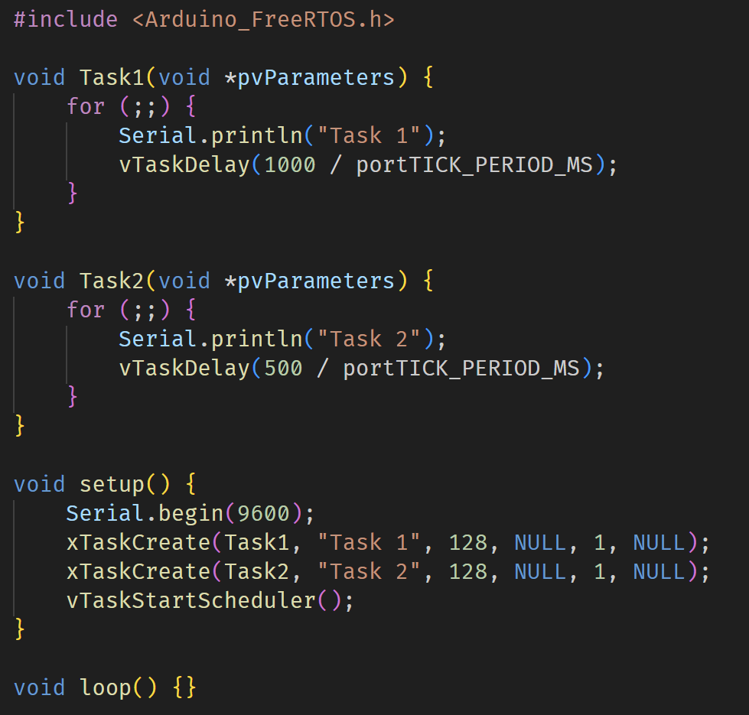
Tasks
Independent units of execution
Sometimes called threads
Main thread creates or spawns tasks
Scheduler responsible for switching between tasks

Slide 18
Common Task States
Running: Currently executing on the CPU
Ready: Ready to execute, waiting for CPU time
Blocked: Waiting for an event or resource
Suspended: Explicitly suspended by the application
Terminated: Task has finished execution
Exact terminology or set of states may differ

Slide 19
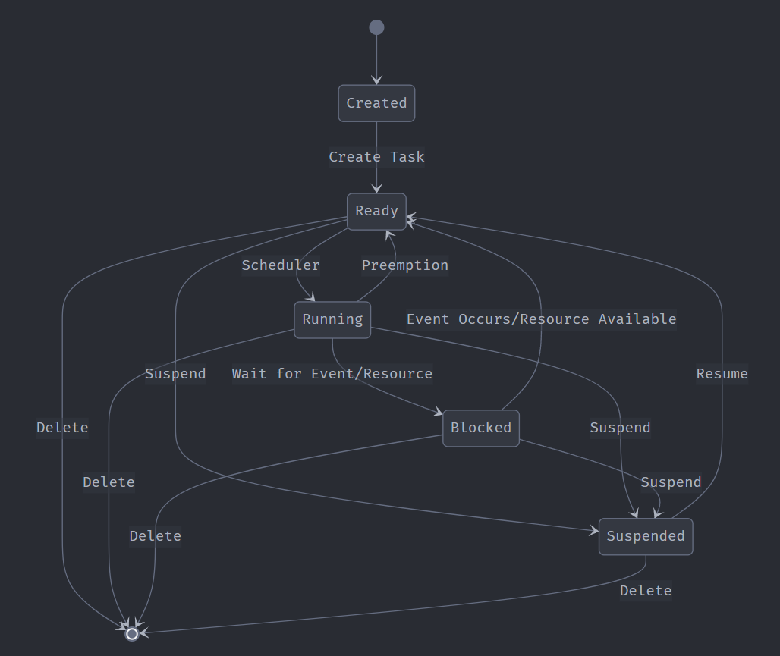

Slide 20
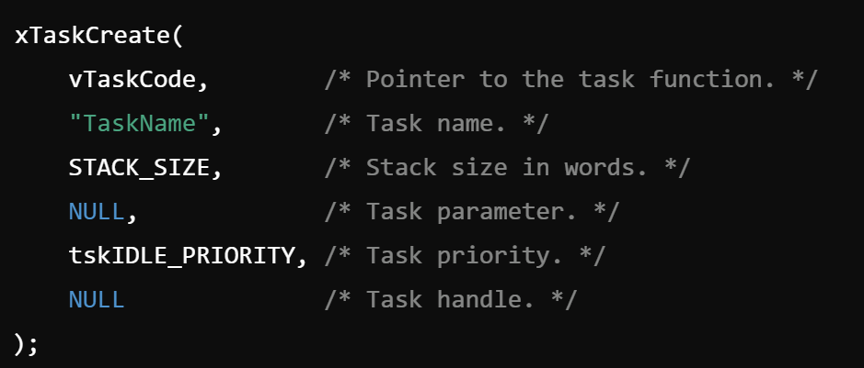
Task Management
Creation:
Allocating memory for task stack and control block
Initializing task context
Adding task to the scheduler's ready list
Deletion:
Removing task from scheduler's lists
Freeing allocated memory
Handling resource cleanup

Slide 21
Types of Tasks
Run-once and exit
Usually for initial setup and management
Forever loop
Wait for conditions to be satisfied and respond: while(1), for(;;) etc. used
Often timer-based
Event based
Invoked on events (could be timer)
Interrupts etc.

Slide 22
Scheduling

Slide 23
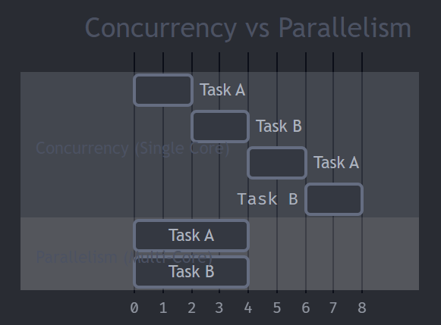
Multi-tasking
Simulate the ability to run multiple tasks simultaneously
Need not have multiple physical processor cores!
Just run fast enough to fool the user
Concurrency
Ability to run different program units in different orders
Need not physically run in parallel
Can be simulated without having parallel hardware
Parallelism
Simultaneous execution of tasks on different processors
Requires concurrency
Tasks are actually running at the same time

Slide 24
Scheduling Concurrent Tasks
Task creation - sets up two tasks and registers them with scheduler
Tasks call “delay” function
sleep or give back control to scheduler to allow other tasks to run
Scheduler tracks time and returns to middle of function
Not calling the function fresh each time!

Slide 25
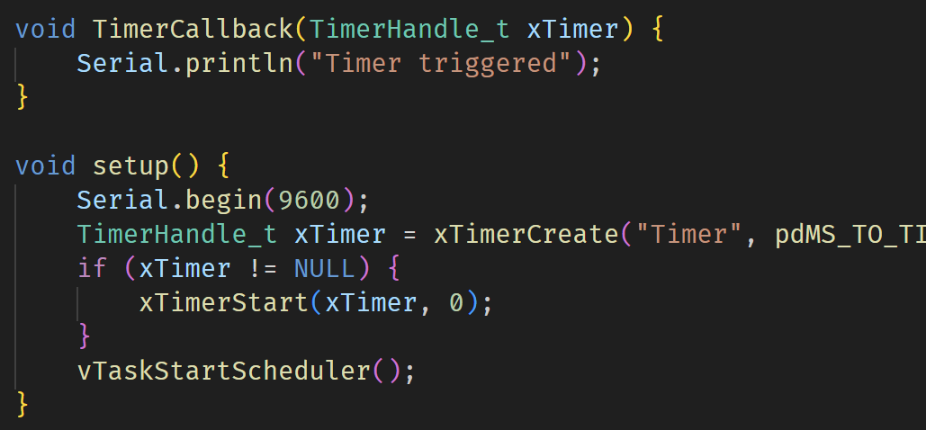
Timers
Most common type of task
Periodic - automatic schedule
Callback with timer interrupt
Explicit “TaskDelay”, “TaskDelayUntil” functions

Slide 26
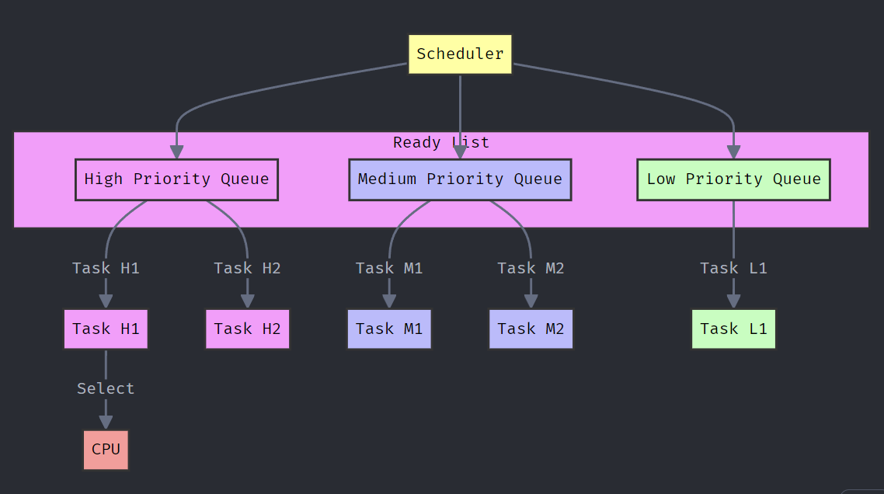

Slide 27
Problems
Deadlock:
Tasks waiting for each other’s resources
Starvation:
Task never gets CPU time due to higher priority tasks
Priority inversion:
Low priority task blocks high priority task if it has control of a shared resource

Slide 28
Communication

Slide 29
Communicating between Tasks
Shared data:
Both tasks access same variables: scope issues
Global variables: who changes what and when?
Explicitly pass messages
Synchronization
Guaranteed delivery of messages
Order of delivery of messages

Slide 30
Queues
First-In First-Out data structure
Simple to implement
Array + pointers
Careful use of function calls for managing data
In-order delivery of messages guaranteed
Size (capacity) of queue important to choose carefully

Slide 31
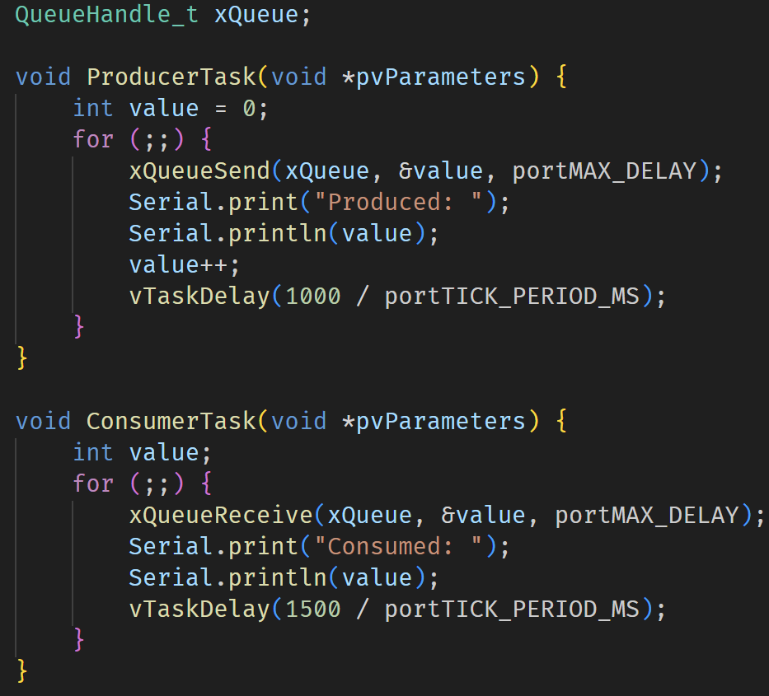
Queue Example
Producer-Consumer model
Producer: generates data and writes to queue
Consumer: waits for data and consumes when present
Blocking and Non-blocking writes/reads
Buffer overflow

Slide 32
Synchronization

Slide 33
Inter-task synchronization
One aspect of communication
May be needed for controlling access to shared resources
Signaling to indicate
Task completed
Data availability
Resource availability

Slide 34
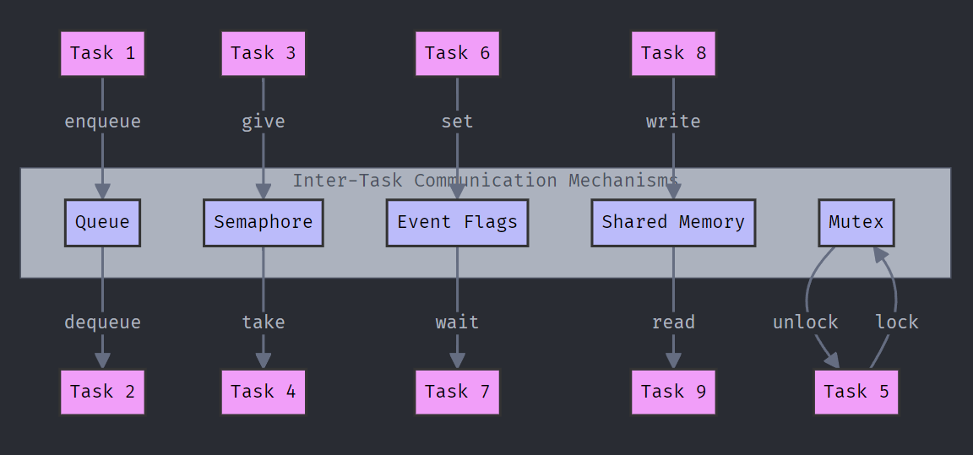

Slide 35
Semaphores and Atomic operations
Semaphore:
Count number of times a particular resource is acquired
If more tasks are waiting, they wait for count on semaphore to come below limit
Problem:
while incrementing/decrementing counter, another task may take over
Atomic operations:
ensure increment/decrement happen without interruption
Can be used to “guard” entire sections of code

Slide 36
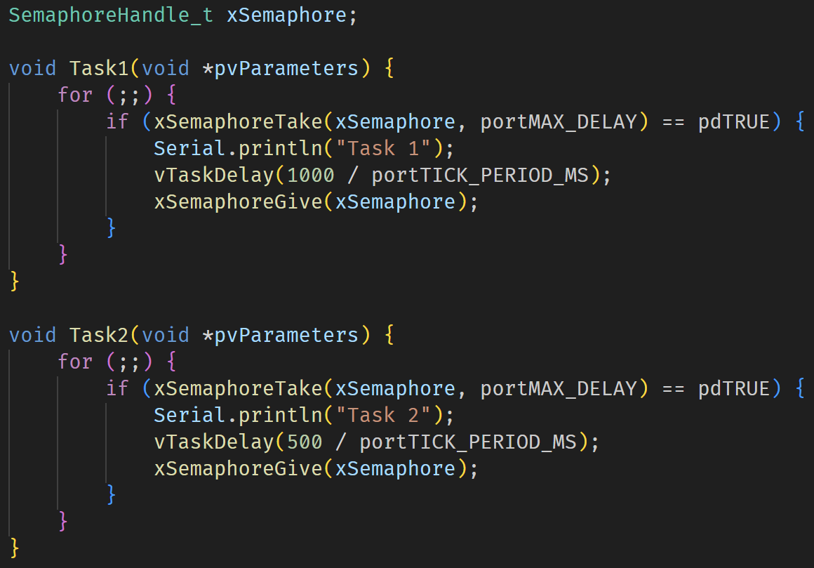
Semaphore usage

Slide 37
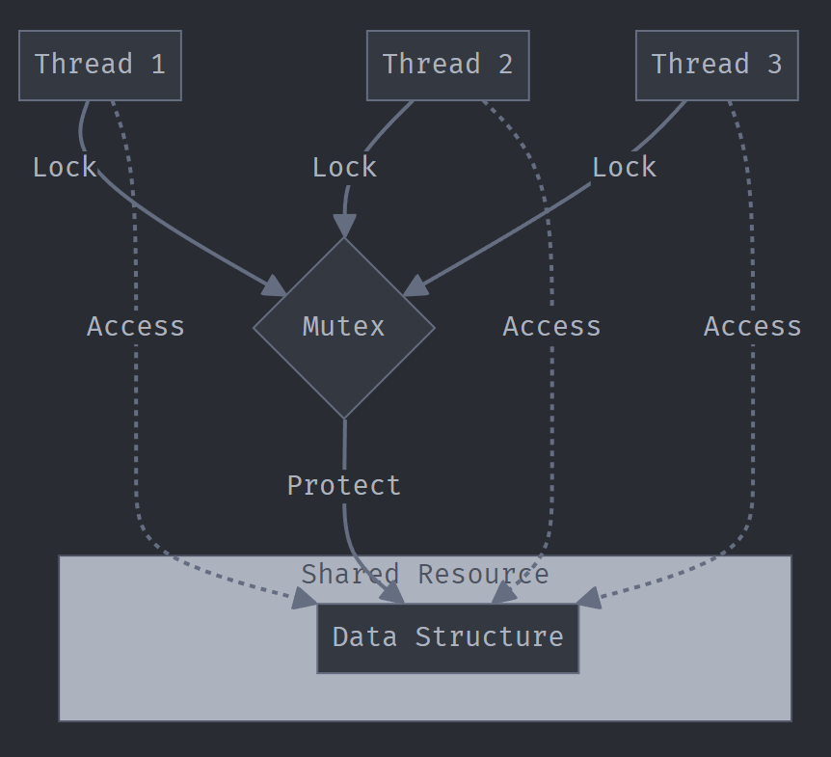
Mutex
Special case of binary semaphore
Mutually-Exclusive access to resource
Only one task can access at a time
Examples:
Shared hardware resources
Log files
Database connections

Slide 38
Lock-free mechanisms
No need to block on mutex or semaphore
Rely on availability of atomic operations
Progress guarantees possible
Can completely avoid deadlock - no locking of resources
Performance
Generally preferable for resource constrained systems - higher performance
Predictable, Scalable
More complex to implement

Slide 39
Interrupts

Slide 40
Interrupts and Tasks
Interrupts must NOT be long running
High priority, can block others
May need to service another interrupt
Tasks can perform longer running tasks
May not be suitable to directly connect to interrupt
Deferred interrupt handling: ISR handles the interrupt, but defers actual work to a separate task

Slide 41
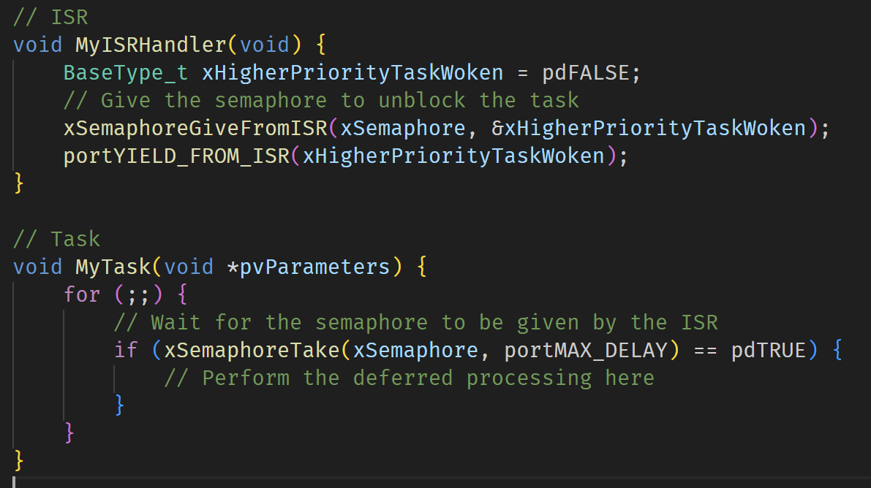
ISRs and Semaphores

Slide 42
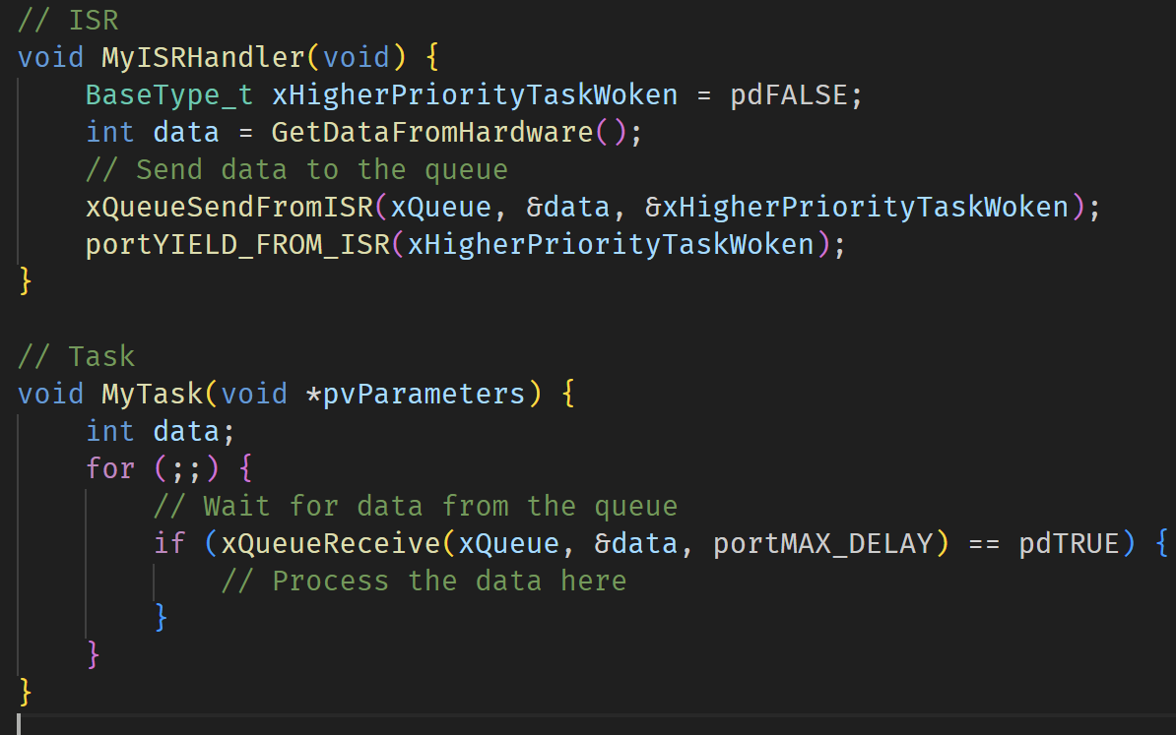
ISRs and Queues

Slide 43
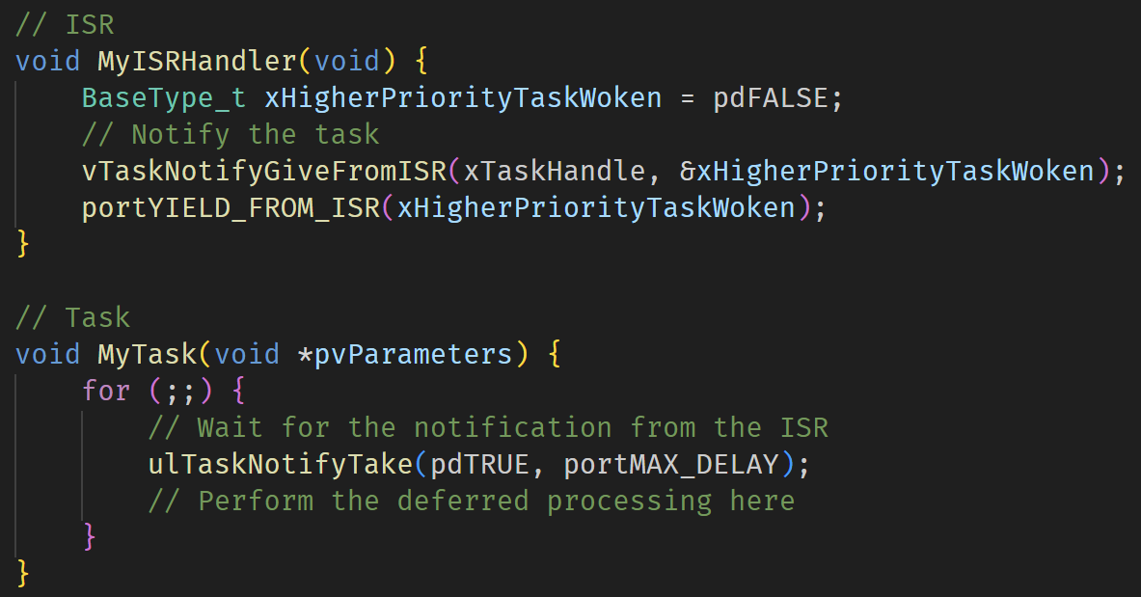
ISRs and Task Notifications

Slide 44
Putting it all together

Slide 45
Complex Task
A sensor task that periodically reads a simulated sensor value and sends the data to a queue.
A processing task that receives the sensor data from the queue and processes it.
An interrupt service routine (ISR) that signals an event, such as an external button press.
Semaphore usage to synchronize tasks.
Stack overflow detection and dynamic memory allocation monitoring.

